Slide 1


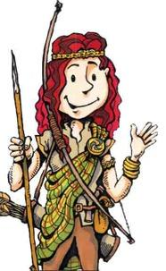







Slide 2
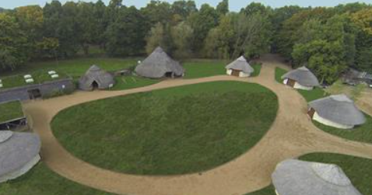
Celtic Harmony
9th - 10th July

Slide 3

Health and safety is a top priority of Celtic Harmony Camp
Celtic Harmony Camp are accredited by Adventure Activities Licensing Authority (AALA), Adventure mark and the Council for Learning Outside The Classroom Quality Badge
Risk assessments are the basis of all activities and programmes to ensure effective health and safety management
Celtic Harmony Camp is secured by fencing, with the gates locked at night. An education team member and first aider is on site overnight. All employees undergo enhanced DBS checks and regular reviews

Slide 4
Miss Cooper Mrs Courchee
Adults
Mrs Hopping Miss K
(first aid)

Slide 5
Departing School - Thursday 9th July
Coaches have been booked for a 9.30am departure from school. Please bring the children (and their luggage) into the hall at normal time.
If you would like to wave your child off, meet us at the hairdressers at 9.30am.
There will be the following stations set up:
Medical – Mrs Hopping
Permission letter with dosage and clearly labelled.
Letters – Miss K
Children will read these on Wednesday night.
Named envelope
Money – Miss Cooper
No more than £5
Named envelope and amount

Slide 6
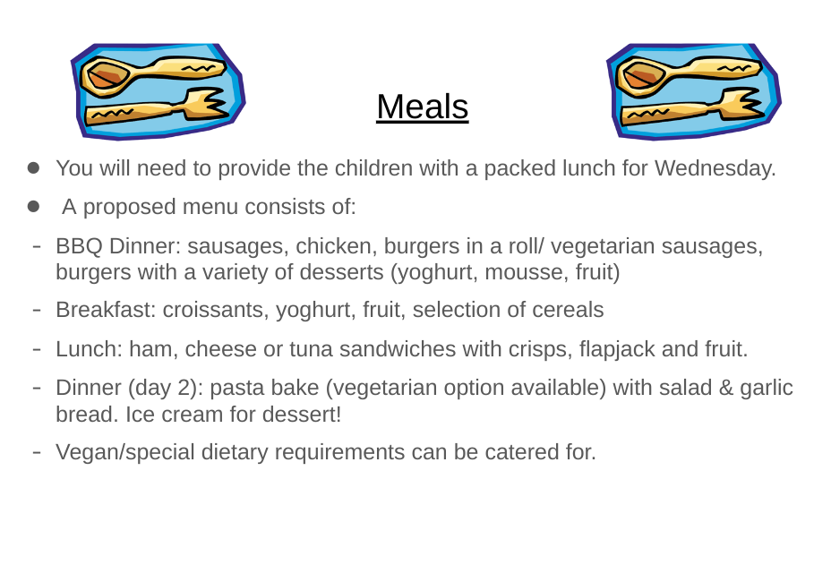
Thursday

Slide 7
Day 1 Stone Age – Thursday 9th July
Day Activities - subject to change
10:15am arrival and brief on health and safety
Prehistory Palisade Performance and Friction Fire Lighting Display
Den building
Flint and Hunting
Gathering and Cooking
Evening Activities
BBQ Dinner
Celtic Crafts
Bat Walk and Marshmallow Roasting

Slide 8
Day 2 Iron Age Warrior
Day Activities
8:30am continental breakfast
Rush Headbands and Face Painting
Archery
Woodland Quest
Packed lunch provided by camp
Gift shop

Slide 9

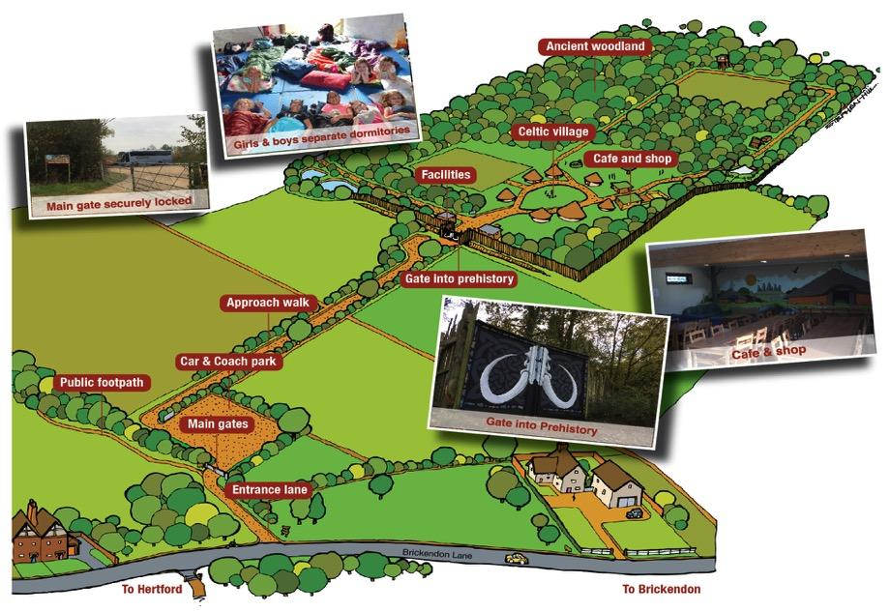

Slide 10
Classes will be split into boys and girls round houses each sleeping up to 12
Bedtime will be approximately 9pm. This is subject to change depending on evening activities
Staff members as well as fully trained and DBS checked member of Celtic Harmony staff on site overnight in case of emergency

Slide 11

Packed lunch for Day 1
Warm sleeping bag
Pillow
Pyjamas
Clothes – comfortable and not brand new! E.g. tracksuits, leggings
Socks and underwear + extra!
Waterproof clothing
Sun hat and sun cream
Comfortable footwear that you don’t mind getting dirty (e.g. old trainers, walking boots)
PLEASE LABEL ALL ITEMS!
NO ELECTRONICS/ VALUABLES OR TUBS OF SWEETS.
Wellington boots (weather dependent)
Toothbrush and toothpaste
Hairbrush and anything else for the morning routine
Torch (if you have one)
Water bottle
Money for trading activity (no more than £5)

Slide 12

There are various toilet facilities on site – standard flushable loos, urinals, and eco composting toilets
Outside and inside hand washing facilities are available with soap and paper towels
The toilet facilities are very close to the roundhouses and the path will be lit
Each roundhouse has its own animal symbol

Slide 13
Trading
The children will have a unique opportunity to trade and role-play using real Artefacts in the Maths Challenge as Farmers, Hunters, Miners etc. and exchange/trade for goods of different values using numeracy skills. Then children use Maths to convert their trip pocket money into reproduced Celtic coins, to choose a souvenir from the Trading Post.
In order for the children to take part in the trading game please ensure that they bring pocket money to trade in the shop (suggested spending money £2 - £5, products start from £1).

Slide 14
Any questions? ☺

